Slide 1
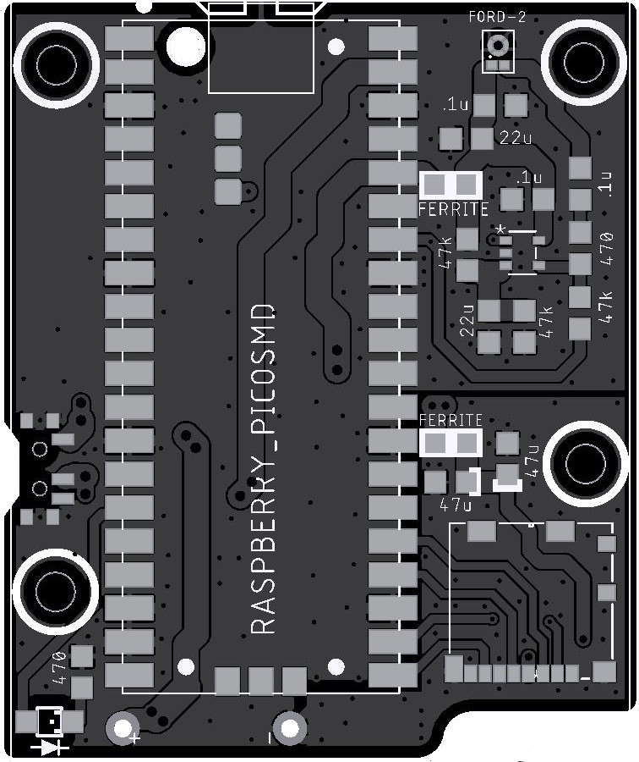
PippyG v 4.04 (2/5/26)
20 components in total
Raspberry Pi Pico x 1
Push/Pull Micro SD card holder x1
Switch slide x 1
IC opamp gp 1 x 1 (note pin 1 dot)
Mic mems analog Syntiant (Ford) x 1
Capacitors (7)
47 uF tant/poly x 2
0.1uF Ceramic x 3
22uF Ceramic x 2
Resistors (21)
47k ohm x 3
Ferrite 500 ohm x 2
470 ohm x 2
LED x 1 (note polarity!)
Back cover
Battery holder AA 3 cell pin

