Slide 1
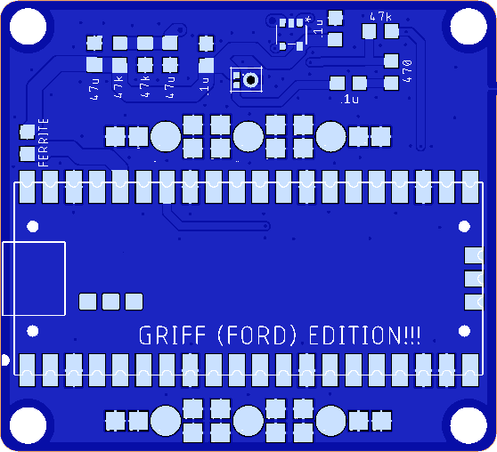
Mini Griff mic v4 – 21Apr26
14 components in total
Raspberry Pi Pico x 1
38mm Brooch Pins x 2
Ford-2 Microphone x 1
IC OpAmp GP 1 SOT23-5 x 1 (note pin 1)
Capacitors (5)
0.1uF Ceramic x 3
47uF Ceramic x 2
Resistors (5)
47k ohm x 3
470 ohm x 1
Ferrite 500 ohm x 1

