Slide 1
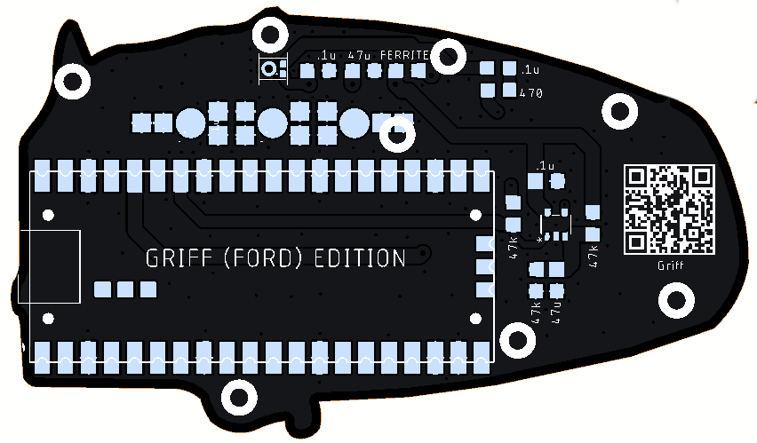
Griff – 20thApr26
14 components in total
Raspberry Pi Pico x 1
38mm Brooch Pin (Option)
Ford-2 Microphone x 1
IC OpAmp GP 1 x 1 (note pin 1)
Capacitors (5)
0.1uF Ceramic x 3
47uF Ceramic x 2
Resistors (5)
47k ohm x 3
470 ohm x 1
Ferrite bead 500 ohm x 1
Back Cover (Option)

