Slide 1
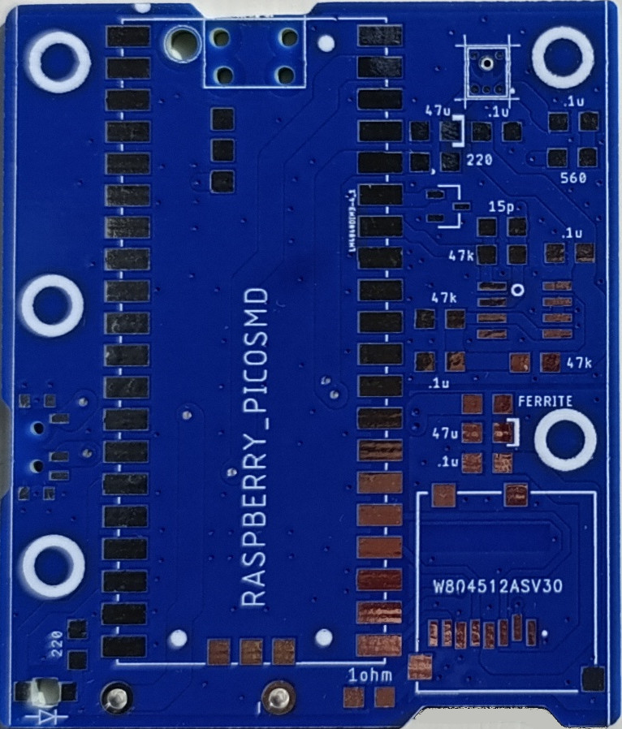
PippyG v 3-71
Raspberry Pi Pico x 1
Micro SC card holder x1
Switch slide x 1
Mic mems analog x 1
IC vref Shunt x 1
IC opamp gp 2 x 1 (note pin 1 dot)
Capacitors
47 uF trant/poly x 2 (note polarity)
0.1uF C0G/NP0 x 5
15 pF C0G/NP0 x 1
Resistors
47k ohm x 3
220 ohm x 2
560 ohm x 1
1 ohm x 1
Ferrite Bead 500 ohm x1
LED x 1 (note polarity)
Back cover
Battery holder AA 3 cell pin

