Slide 1
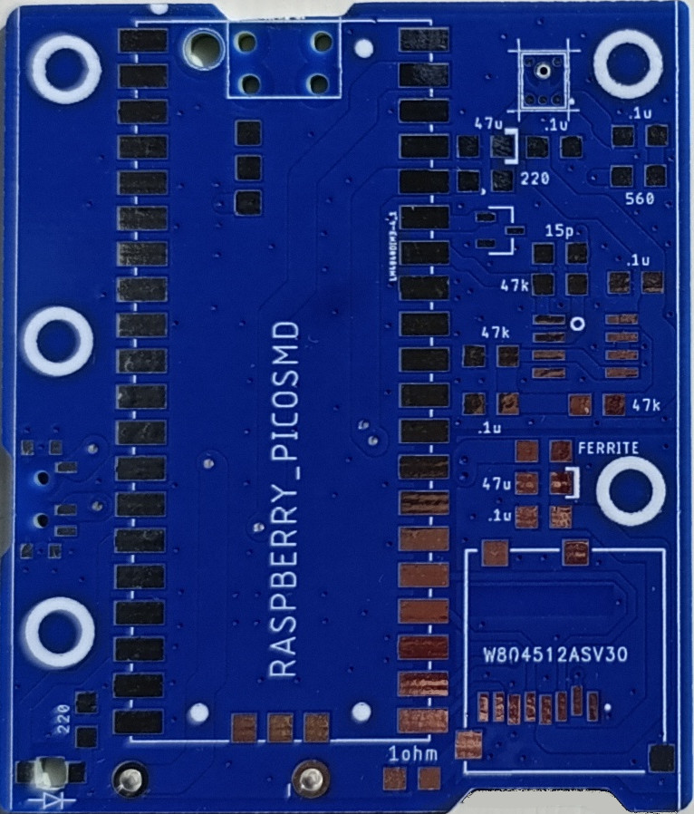
PippyG v 3-71 (update 31/10/25)
Raspberry Pi Pico x 1
Micro SC card holder x1
Switch slide x 1
Mic mems analog x 1
IC opamp gp 2 x 1 (note pin 1 dot)
Capacitors
47 uF tant/poly x 2 (note polarity)
47 uF Ceramic x 2 (replaces 0.1uF)
0.1uF C0G/NP0 x 5
Resistors
47k ohm x 3
220 ohm x 1
470 ohm x 1 (replaces 560)
100 ohm x1 (replaces 220)
1 ohm x 1
Ferrite Bead 500 ohm x1
LED x 1 (note polarity)
Back cover
Battery holder AA 3 cell pin
Special notes for 31/10:
Some solder pads not used.
Some components are different to what it says on board.
Follow this diagram!

