Slide 1
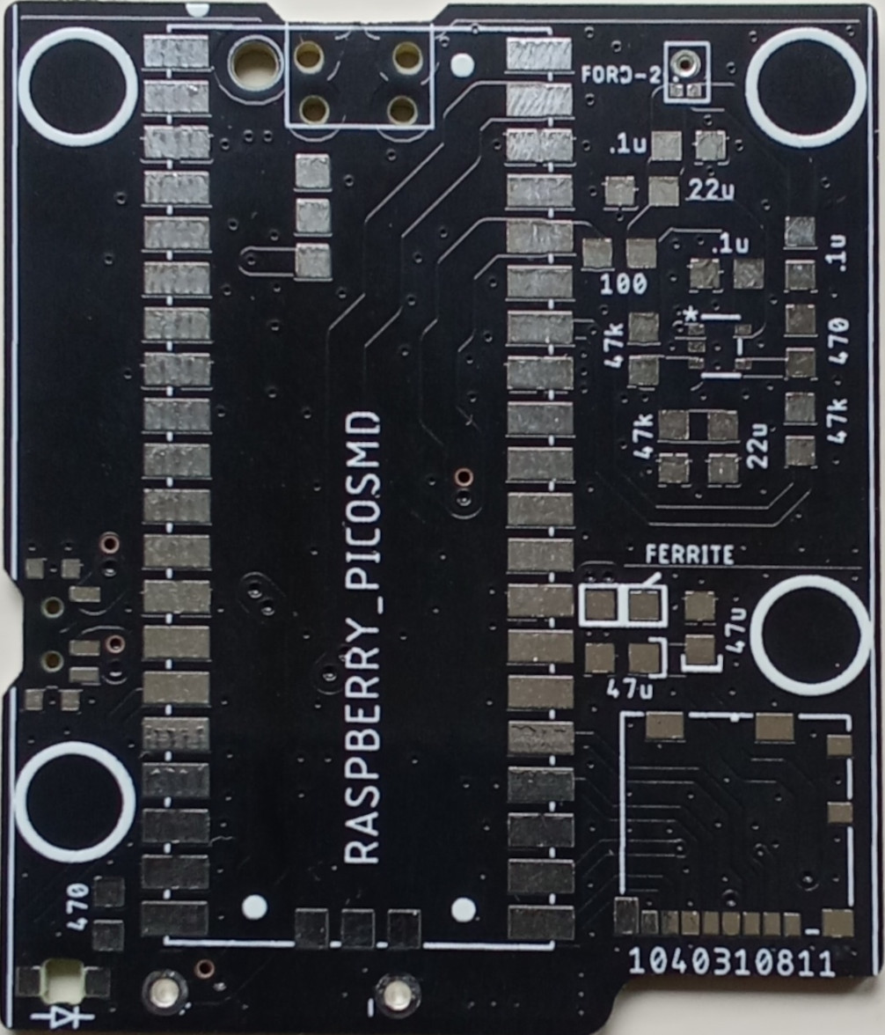
PippyG v 4.03 (update 27/11/25)
Raspberry Pi Pico x 1
Push/Pull Micro SD card holder x1
Switch slide x 1
Ford-2 Microphone x 1
Single channel opamp gp 1 x 1 (note pin 1 dot)
Capacitors
47 uF tant/poly x 2
22 uF Ceramic x 2
0.1uF Ceramic (C0G/NP0) x 3
Resistors
47k ohm x 3
470 ohm x 2
Ferrite Bead 500 ohm x2
(one replaces 100 ohm)
LED x 1 (note polarity)
Back cover
Battery holder AA 3 cell pin
Special notes:
One component is different to what it says on board.
Follow this diagram!

