Slide 1
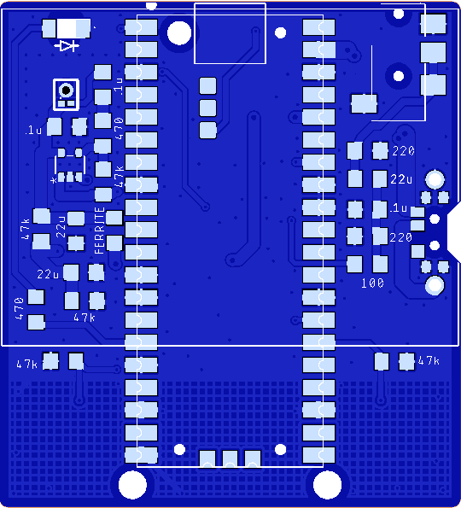
Nano PiPistrelle – 8Jun26
23 components in total
Raspberry Pi Pico x 1
Switch slide x 1
Audio jack, 3.5 mm x 1
Mic mems analog Syntiant (Ford) x 1
IC opamp gp 1 x 1 (note pin 1 dot)
Capacitors (7)
0.1uF Ceramic x 3
22uF Ceramic x 3
Resistors (21)
47k ohm x 5
Ferrite 500 ohm x 1
220 ohm x 2
100 ohm x 1
470 ohm x 2
LED x 1 (note polarity!)
Back cover
Battery holder AAA 3 cell pin

