Slide 1
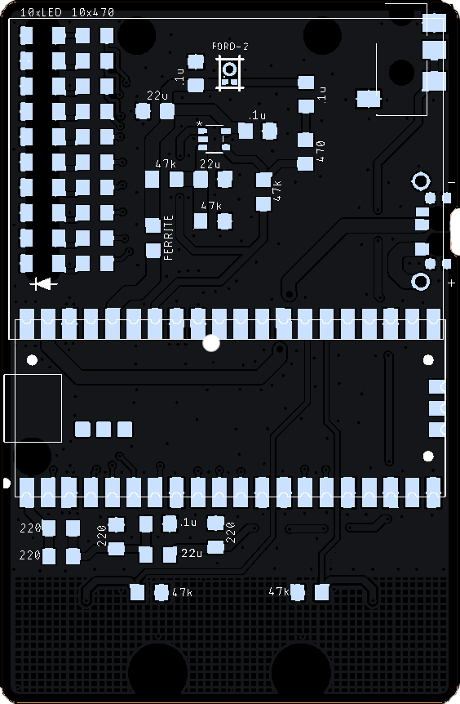
Mini PiPistrelle – 14Feb’26
43 components in total
Raspberry Pi Pico x 1
Switch slide x 1
Audio jack, 3.5 mm x 1
IC opamp gp 1 x 1 (note pin 1 dot)
Mic mems analog Syntiant (Ford) x 1
Capacitors (7)
0.1uF Ceramic x 4
22uF Ceramic x 3
Resistors (21)
47k ohm x 5
Ferrite 500 ohm x 1
220 ohm x 4
470 ohm x 11
LED x 10 (note polarity!)
Back cover
Battery holder AAA 3 cell pin

