Slide 1
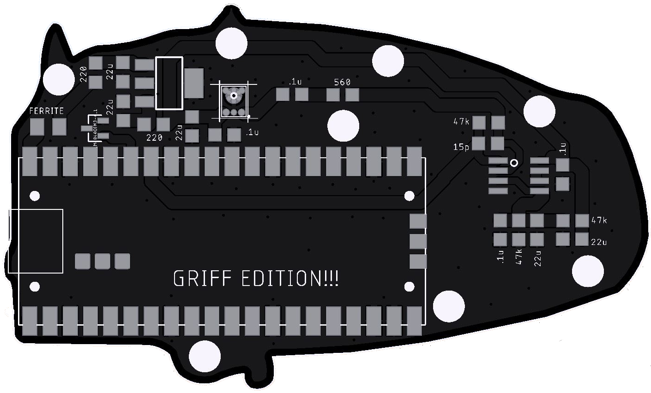
Griff mic – v1
Raspberry Pi Pico x 1
Mic mems analog x 1
IC Reg Linear 3.3V
IC vref Shunt
IC OpAmp gp 2 x 1 (note pin 1 dot)
Capacitors
0.1uF Ceramic x 4
22 uF Ceramic x 5
15 pF Ceramic x 1
Resistors
47k ohm x 3
220 ohm x 2
560 ohm x 1
Ferrite Bead 500 ohm x 1
Back cover

