Slide 1
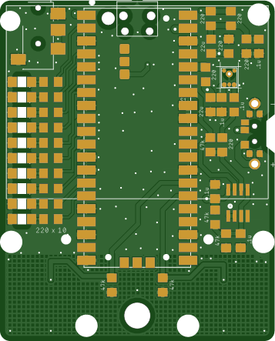
mini PiPistrelle – v2 - 5Nov24
Raspberry Pi Pico x 1
Switch slide x 1
Audio jack, 3.5 mm x 1
Mic mems analog x 1
IC opamp gp 2 x 1 (note pin 1 dot)
Capacitors
0.1uF Ceramic x 5
22uF Ceramic x 2
Resistors
47k ohm x 5
220 ohm x 16
LED x 10 (note polarity!)
Back cover
Battery holder AAA 3 cell pin

