Slide 1
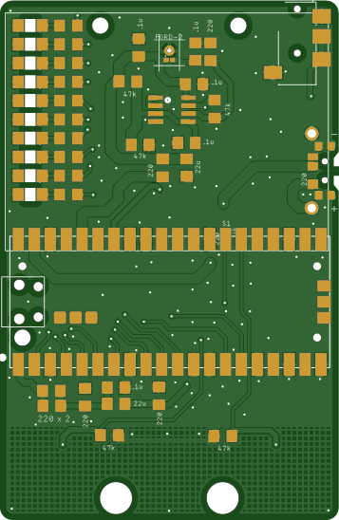
mini PiPistrelle – 18Apr25
Raspberry Pi Pico x 1
Switch slide x 1
Audio jack, 3.5 mm x 1
Mic mems analog Syntiant (Ford) x 1
IC opamp gp 2 x 1 (note pin 1 dot)
Capacitors (7)
0.1uF Ceramic x 5
22uF Ceramic x 1
47uF Ceramic x 1 (replaces 22uF - polarity)
Resistors (21)
47k ohm x 5
220 ohm x 15 (note 3 are vertical)
100 ohm x 1 (replaces 220 on board)
LED x 10 (note polarity!)
Back cover
Battery holder AAA 3 cell pin

